Slide 1
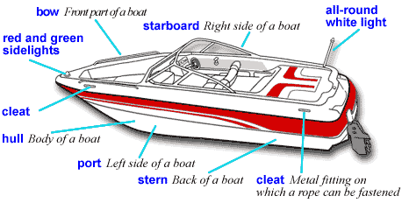
MOTORBOAT TRAINING, Testing and licensing
Presenter:
Title: Boats/Personal Watercraft and Boat Maintenance
Manual – TAB 2
Date:

Slide 2
Boats and Boat Maintenance
Objectives:
Understand the proper terminology for a boat
Understand hull types and their characteristics
Understand the Capacity Plate
List normal maintenance procedures for the boat and motor
List common problems associated with outboard motors and typical troubleshooting procedures

Slide 3
Length Classes
Class A - Less than 16 feet
Class 1 - 16 feet to less than 26 feet
Class 2 - 26 feet to less than 40 feet
Class 3 - 40 feet to less than 65 feet

Slide 4
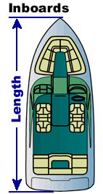
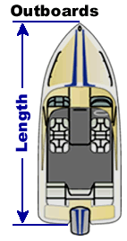
Length of a Vessel
Vessel’s overall length determines the equipment required to comply with federal and state laws.

Slide 5
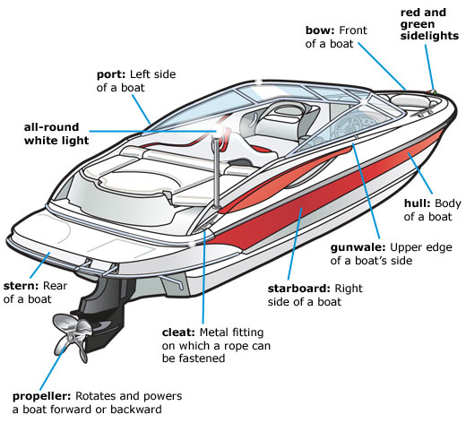
Introduction to Boats

Slide 6
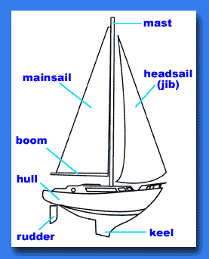
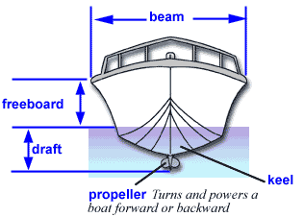
Introduction to Boats

Slide 7
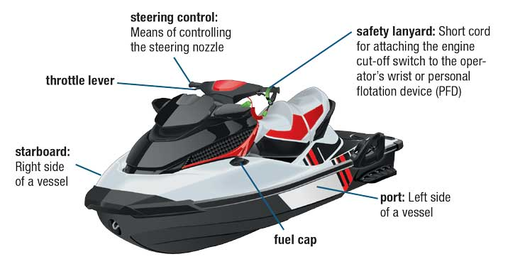
Personal Watercraft

Slide 8
Hull Types
Flat bottom boats are typically small open boats such as johnboats. Flat-bottomed boats can easily get "on plane" or ride on top of the water at high speeds. Flat bottom do not handle well in choppy or rough water, especially at planing speeds. Flat-bottomed boats are not very stable; caution should be used when moving around them.
Round bottom boats almost "glide" through the water. Because round-bottomed boats are very efficient at moving through water, most cruising sail and powerboats have rounded hulls. Typically, round-hulled boats move at slow speeds.
"V-hulls" are designed to operate at high speeds and to "cut" through rough water. V-hulls are not as efficient as flat or round-bottomed boats, and need larger engines to move at similar speeds.
Cathedral or multi-hulls, are two or more hulls attached together. This combination of hulls allows for much more stability than what is found in other hull forms. The air pocket that is formed between the hulls may also provide lift, helping the boat get on plane more easily and increasing efficiency.
Notes:
Types of hulls.
1. Displacement hulls move through the water. These hulls are slow but very stable. Boats with displacement hulls are designed to cut through the water with a minimum of propulsion. Most sailboats and large cruisers have displacement hulls to allow them to travel more smoothly through the water.
2. Planing hulls move on top of the water. These hulls are fast but less stable than a displacement hull. Boats with planing hulls are designed to rise up and glide on top of the water when enough power is supplied. Most small powerboats, including personal watercraft (PWC) have planing hulls allowing them to travel more rapidly across the water.
Hull shapes.
1. Flat Bottom. Flat bottom boats are typically small open boats such as johnboats. Flat-bottomed boats can easily get "on plane" or ride on top of the water at high speeds. Flat bottom boats are typically intended for use on calm waters such as ponds, small lakes, and slow rivers because they do not handle well in choppy or rough water, especially at planing speeds. Flat-bottomed boats are not very stable; caution should be used when moving around them.
2. Round Bottom. Round bottom boats almost "glide" through the water. Because round-bottomed boats are very efficient at moving through water, most cruising sail and powerboats have rounded hulls. Typically, round-hulled boats move at slow speeds.
3. Deep-V hull. "V-hulls" are designed to operate at high speeds and to "cut" through rough water. V-hulls are not as efficient as flat or round-bottomed boats, and need larger engines to move at similar speeds.
4. Cathedral hull. Cathedral or multi-hulls, are two or more hulls attached together. This combination of hulls allows for much more stability than what is found in other hull forms. The air pocket that is formed between the hulls may also provide lift, helping the boat get on plane more easily and increasing efficiency.

Slide 9
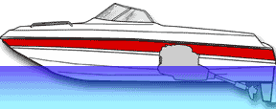
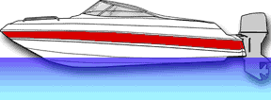
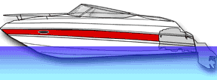
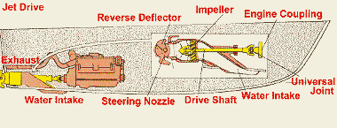
Engine Types
Inboard
Outboard
Inboard/Outboard
Jet Drive
Notes:
Inboard motors are mounted inside the hull's midsection or in front of the transom. An inboard on a boat is a four-stroke automotive engine adapted for marine use. The engine turns a drive shaft that runs through the bottom of the hull and is attached to a propeller at the other end. Steering of most inboard boats is controlled by a rudder behind the propeller.
Outboard motors are a complete power unit, including an engine, gear case and propeller, mounted on the transom of the boat. Outboards range in size from under one horsepower (hp) to more than 300 hp. Outboards include electric trolling motors. Outboards have a higher horsepower-to-weight ratio than other engine types. Most outboards have separate fuel tanks that are either portable or built into the boat, although smaller motors have self-contained fuel tanks. Outboards are internal combustion engines. A growing number of outboard engines are of four-stroke design; but most are still two-stroke engines, which require oil to be mixed with the fuel to properly lubricate the engine. Steering of outboard boats is controlled by a tiller steering wheel, which swivels the entire engine to direct propeller thrust.
Inboard/Outboard (I/O) motors combine features found on both inboard and outboard engines. Stern drive motors are mounted inside the boat and attached through the transom to a drive unit, which resembles the lower section of an outboard. Stern drives are four-stroke automotive engines adapted for marine use. The engine turns a drive shaft that runs through the transom and is attached to a propeller at the other end. Steering is controlled by a drive unit that swivels like an outboard.
Jet Drive systems have the advantage of having no propeller to cause potential danger to people in the water and marine life. They are usually inboard engines that take in water, which flows through a pump powered by an impeller. The water is then discharged at high pressure through a nozzle that propels the boat forward. The nozzle swivels to provide steering to the boat. Most personal watercraft use jet drives.

Slide 10
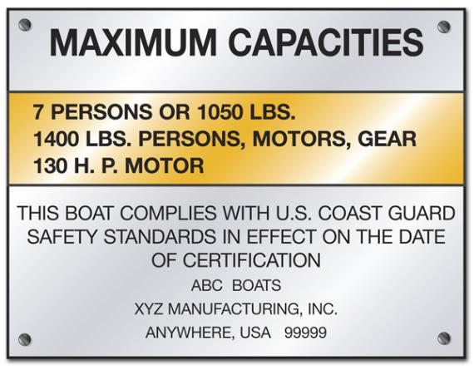
Capacity Plate
* If no Capacity Plate use:
length x width
15
to calculate the number of 150 lb. people the vessel can carry safely
Federal law requires capacity plates on boats less than 20’

Slide 11
Propeller Types
Plastic – used in low horsepower situations, blades tend to cup
Aluminum – good strength, corrosion resistant, can chip and bend
Stainless Steel – strong, expensive but strikes may transfer damage to other parts of engine

Slide 12
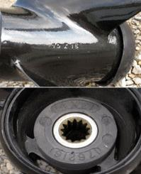
Diameter and Pitch
The number stamped on the prop refers to the prop’s diameter and pitch. Example: 10x15 mean the prop has a 10-inch diameter and a 15-inch pitch. (typically marked on the prop tube or within the hub)
a. Diameter is the distance across the circle described by the blade. As a rule, a slower turning, larger diameter propeller is more efficient than a faster turning, small diameter propeller.
b. Pitch is a product of the propeller’s diameter and the rake of its blades and is the distance in inches the prop should travel forward in one revolution.

Slide 13
Boat/Prop Match Up
Find the recommended wide-open throttle (WOT) rpm in the owner’s manual
Make test runs
If WOT is too high, install larger pitch
If WOT is too low, install smaller pitch

Slide 14
Routine Motor Maintenance
Lubricate fittings and drive parts
Change lower unit lubricants and impeller every 100 hours or once per season
Inspect spark plugs
Check motor for loose connections, leaks, or loose parts
Examine propeller

Slide 15
Trouble Shooting: Engine fails to start, loses power, or stops while under way.
Check gas
Check fuel tank valves and fuel line connections
Check battery connections
Loose wire in the ignition circuit
Fuel not reaching cylinders
Overheated engine (check tell-tale for water stream)
Fouled spark plug
Carburetor needs adjustment
Improper oil/fuel mixture
Kill switch disengaged

Slide 16
Trouble Shooting: Engine seems to run well but lacks power while under way
Improper mounting
Incorrect tilt angle or improper load distribution
Fouled propeller or lower unit
Damaged prop blades or bushing assembly
Engine knock – loose prop, loose flywheel nut, worn pistons
Excessive water in bilge – check for leak/drain plugs

Slide 17
Review
What are the different HULL shapes and their characteristics?
What does the Capacity Plate on a boat tell you?
What are the names of the front, back, left and right sides of a boat?
What is freeboard?
The width of a boat is called what?
What are the pros and cons of different propeller types?
T/F - An outboard motor is included on the overall length of a boat.
What would a stamped “14X21” indicate on a boat propeller?
T/F - Troubleshooting and maintenance should only be performed by a qualified mechanic.

